Slide 1

SemiT-SAM: Building a Visual Foundation
Model for Tooth Instance Segmentation on Panoramic Radiographs
Team Leader: Jing HAO E-Mail: jinghao@connect.hku.hk
Team Members: Moyun Liu, Lei He, Lei Yao, James Kit Hon Tsoi, Kuo Feng Hung
1

Slide 2

CONTENTS
1. Introduction of SemiT-SAM
2. Training protocols
3. Results
2

Slide 3
01.
Introduction of SemiT-SAM
3

Slide 4
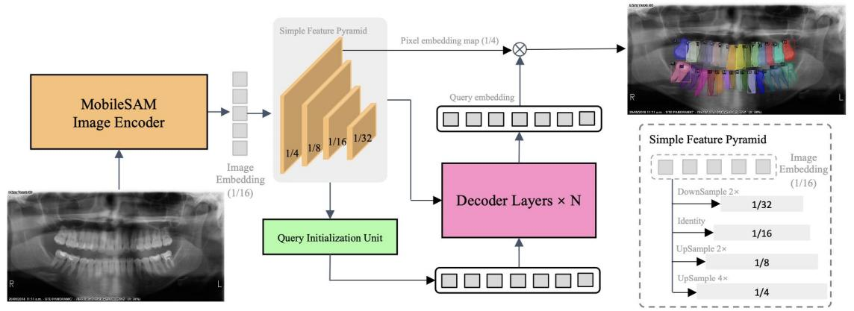
Model Architecture
- ViT-Tiny derived from MobileSAM
- Generating multi-scales features by simple feature pyramid module (from ViTDet)
- Initializing query in the decoder using a query initialization unit.
4

Slide 5
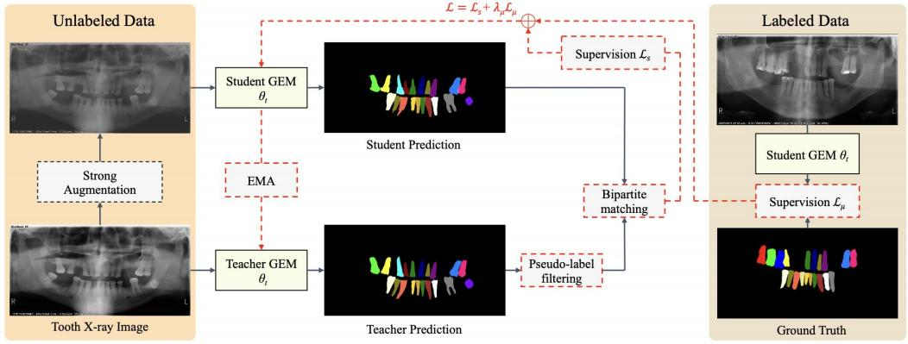
Semi-Supervised Training
1. Teacher pre-training: The teacher model, parameterized by θt, is exclusively trained on annotated data.
2. Enhanced burn-in process: The student model, parameterized by θs, is trained on both labeled and unlabeled data
using pseudo-labels generated by the teacher model in the first pre-training stage. The teacher model is frozen.
3. The student continues to be trained on both labeled and unlabeled data as before. The teacher model is updated
using an exponential moving average (EMA) of the student’s weights.
5

Slide 6

Loss Function
During the training phase, the total loss consists of the supervised and unsupervised losses, which share the same loss function, defined as follows:
The unsupervised loss weight λ_{unsup} is 2 in our experiments. The loss function is structured as a weighted sum of five loss components:
Datasets for Building the Foundation Model
We carefully collected a large-scale dataset, TSI15k, from several open-sourced datasets for training the teeth segmentation foundation model. The dataset is available at: https://huggingface.co/datasets/Bryceee/ TISI15k-Dataset
Our code and checkpoints of teeth foundation model are available at: https://github.com/isbrycee/SemiTNet (accessed on 4 August 2024)
6

Slide 7
02.
Training protocols
7

Slide 8
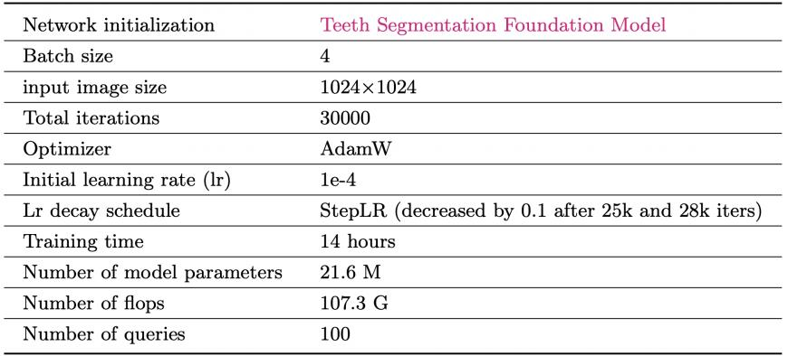
Training protocols
1 Fine-tuning our teeth segmentation foundation model using the provided 30 labeled data in this challenge.
This step was necessary to align the category space because we had originally defined 32 classes in our teeth segmentation foundation model, whereas this challenge defined 52 classes.
2. The unlabeled data were used for semi-supervised training.
8

Slide 9
03.
Results
9

Slide 10
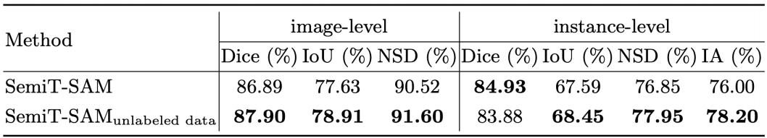
Results
With the help of unlabeled data and semi-supervised training strategy, the performance could be further improved.
All metrics, with the exception of the instance-level Dice, have shown improvement, that is, the enhancements resulted in increases of 1.01% (image-level Dice), 1.28% (image-level IoU), 1.12% (image- level NSD), 0.86% (instance-level
IoU), 1.10% (instance-level NSD), and 2.20% IA.
We believe that since the teeth segmentation foundation model already provides a strong baseline for tooth instance segmentation capabilities, the improvement brought by unlabeled data is limited.
10

Slide 11
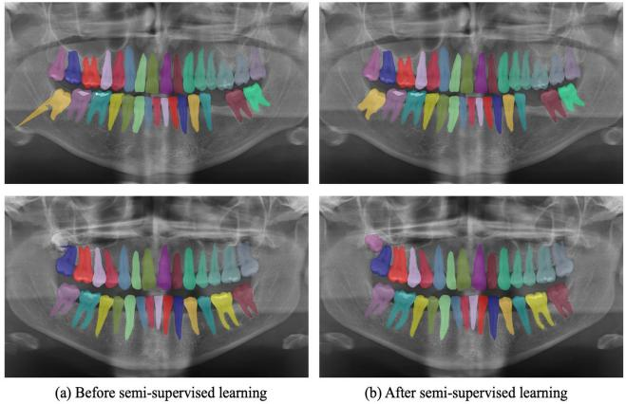
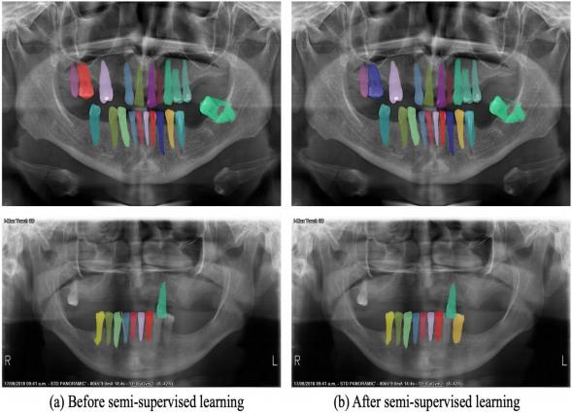
Results
Successful cases Failure cases
11

Slide 12
THANKS
Jing HAO
12

